Slide 1
LESSON 25

Slide 2
Overview
of
Previous Lesson(s)

Slide 3
Over View
Structure of the LR Parsing Table
Consists of two parts: a parsing-action function ACTION and a goto function GOTO.
Given a state i and a terminal a or the end-marker $ ACTION[i,a] can be
Shift j The terminal a is shifted on to the stack and the parser enters state j.
Reduce A → α The parser reduces α on the TOS to A.
Accept
Error

Slide 4
Over View..
The prefixes of right sentential forms that can appear on the stack of a shift-reduce parser are called viable prefixes
A viable prefix is a prefix of a right-sentential form that does not continue past the right end of the rightmost handle.
So it is always possible to add terminal symbols to the end of a viable prefix to obtain a right-sentential form.
SLR parsing is based on the fact that LR(0) automata recognize viable prefixes.

Slide 5
Over View…
Now we shall extend the previous LR parsing techniques to use one symbol of look-ahead on the input.
Two different methods:
The "canonical-LR" or just "LR" method, which makes full use of the look-ahead symbol(s) . This method uses a large set of items, called the LR(1) items.
The "look-ahead-LR" or "LALR" method, which is based on the LR(0) sets of items, and has many fewer states than typical parsers based on the LR(1) items.

Slide 6
Over View…
For LALR we merge various LR(1) item sets together obtaining nearly the LR(0) item sets we used in SLR.
For a comparison of parser size, the SLR and LALR tables for a grammar always have the same number of states.
Several hundred states for a language like C.
The canonical LR table would typically have several thousand states for the same-size language.
It is possible for the LALR merger to have reduce-reduce conflicts when the LR(1) items on which it is based is conflict free.
LALR is the current method of choice for bottom-up, shift-reduce parsing.

Slide 7
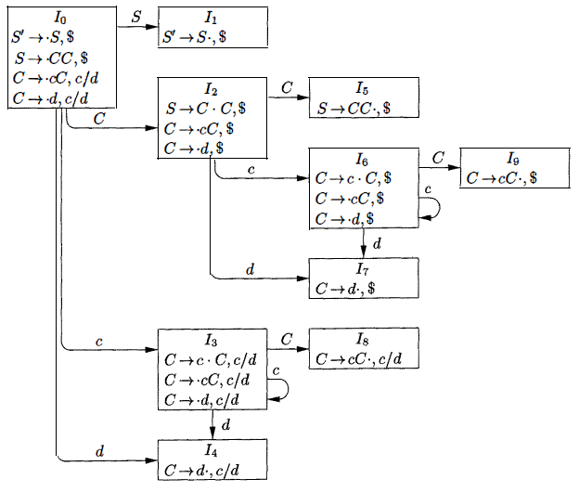
Over View…
To understand it better, we saw our previous grammar and its sets of LR(l) items.
Take a pair of similar looking states, such as 1₄ and I₇
Each of these states has only items with first component C → d∙
Lookaheads
I₄ = c or d, I₇ = $
S’ → S
S → C C
C → c C
C → d

Slide 8
Over View…
Now we can replace I₄ and I₇ by I₄₇ the union of I₄ and I₇ consisting of the set of three items represented by [C → d∙ , c/d/$]
The goto's on d to I₄ or I₇ from I₀ , I₂ , I₃ & I₆ now enter I₄₇
The action of state 47 is to reduce on any input.
So now we look for sets of LR(1) items having the same core, that is, set of first components, and we may merge these sets with common cores into one set of items

Slide 9
Over View…
States Core
I₄ & I₇ C → d∙
I₃ & I₆ C → c∙C
C → ∙cC
C → ∙d
I₈ & I₉ C → cC∙

Slide 10
Over View…
Ex: Merged States
I₄ ₇ = I₄ & I₇ C → d∙ , c/d/$
I₃₆ = I₃ & I₆ C → c∙C , c/d/$
C → ∙cC , c/d/$
C → ∙d , c/d/$
I₈₉ = I₈ & I₉ C → cC∙ , c/d/$

Slide 11
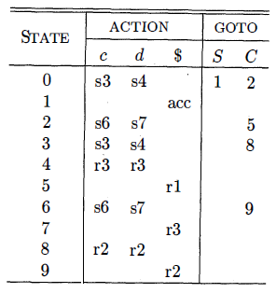
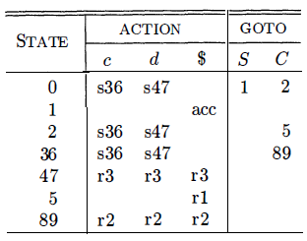
Over View…
Canonical parsing table LALR parsing table

Slide 12
Over View…
For compaction of LR Parsing table a useful technique for compacting the action field is to recognize that usually many rows of the action table are identical.
States 0 and 3 have identical action entries, and so do 2 and 6.
We can therefore save considerable space, at little cost in time, if we create a pointer for each state into a one-dimensional array.
Pointers for states with the same actions point to the same location.

Slide 13
Over View…
To access information from this array, we assign each terminal a number from zero to one less than the number of terminals and we use this integer as an offset from the pointer value for each state.
In a given state, the parsing action for the ith terminal will be found i locations past the pointer value for that state.
Further space efficiency can be achieved at the expense of a somewhat slower parser by creating a list for the actions of each state.

Slide 14
TODAY’S LESSON

Slide 15
Contents
Ambiguous Grammars
Precedence and Associativity to Resolve Conflicts
The "Dangling-Else" Ambiguity
Error Recovery in LR Parsing
Syntax-Directed Translation
Syntax-Directed Definitions
Inherited and Synthesized Attributes
Evaluating an SDD at the Nodes of a Parse Tree
Evaluation Orders for SDD's
Dependency Graphs
Ordering the Evaluation of Attributes
S-Attributed Definitions

Slide 16
Ambiguous Grammars
It is a fact that every ambiguous grammar fails to be LR and thus is not in any of the classes of grammars that we discussed. i.e SLR, LALR
However, certain types of ambiguous grammars are quite useful in the specification and implementation of languages.
For language constructs like expressions, an ambiguous grammar provides a shorter, more natural specification than any equivalent unambiguous grammar.
Another use of ambiguous grammars is in isolating commonly occurring syntactic constructs for special-case optimization.

Slide 17
Ambiguous Grammars..
With an ambiguous grammar, we can specify the special-case constructs by carefully adding new productions to the grammar.
Although the grammars we use are ambiguous, in all cases we specify disambiguating rules that allow only one parse tree for each sentence.
In this way, the overall language specification becomes unambiguous, and sometimes it becomes possible to design an LR parser that follows the same ambiguity-resolving choices.

Slide 18
Precedence and Associativity to Resolve Conflicts
Consider the ambiguous grammar for expressions with operators + and * :
E → E + T | E * T | (E) | id
This grammar is ambiguous because it does not specify the associativity or precedence of the operators + and *
The unambiguous grammar, generates the same language, but gives + lower precedence than * and makes both operators left associative.
E → E + T
T → T * F

Slide 19
Ambiguous Grammars…
There are two reasons why we might prefer to use the ambiguous grammar.
First, we can easily change the associativity and precedence of the operators + and * without disturbing the productions or the number of states in the resulting parser.
Second, the parser for the unambiguous grammar will spend a substantial fraction of its time reducing by the productions
E → E + T & T → T * F
whose sole function is to enforce associativity and precedence.

Slide 20

Dangling-Else Ambiguity
Consider again the following grammar for conditional statements:
This grammar is ambiguous because it does not resolve the dangling-else ambiguity.
Let us consider an abstraction of this grammar & then write the grammar, with augmenting production S’ → S as
S’ → S
S → i S e S | i S | a

Slide 21
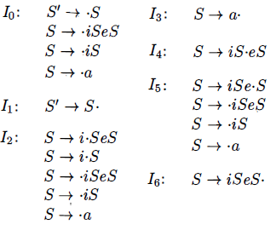
Dangling-Else Ambiguity..
LR(0) items for this grammar:
The ambiguity gives rise to a shift/reduce conflict in I₄
There, S → i S e S calls for a shift of e and, since FOLLOW(S) = {e,$} item S → iS calls for reduction by S → iS on input e
What we should do ..??

Slide 22
Dangling-Else Ambiguity...
The answer is that we should shift else, because it is "associated" with the previous then.
The e on the input, standing for else, can only form part of the body beginning with the iS now on the top of the stack.
If what follows e on the input cannot be parsed as an S completing body iSeS then it can be shown that there is no other parse possible.
We conclude that the shift/reduce conflict in I₄ should be resolved in favor of shift on input e.

Slide 23
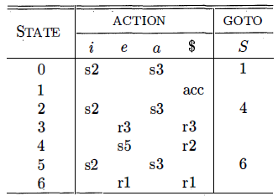
Dangling-Else Ambiguity...
The SLR parsing table constructed from the sets of LR(0)items of using this resolution of the parsing-action conflict in I₄ on input e

Slide 24
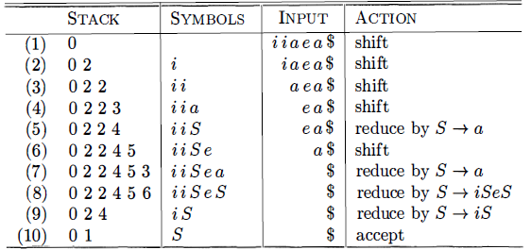
Dangling-Else Ambiguity...
Ex: For input iiaea the parser makes the following moves, corresponding to the correct resolution of the dangling-else.
At line (5) , state 4 selects the shift action on input e, whereas at line (9) , state 4 calls for reduction by S → iS is on input $

Slide 25
Error Recovery in LR Parsing
An LR parser will detect an error when it consults the parsing action table and finds an error entry.
An LR parser will announce an error as soon as there is no valid continuation for the portion of the input thus far scanned.
A canonical LR parser will not make even a single reduction before announcing an error.
SLR and LALR parsers may make several reductions before announcing an error, but they will never shift an erroneous input symbol onto the stack.

Slide 26
Error Recovery in LR Parsing..
In LR parsing, panic-mode error recovery can be implemented.
Scan down the stack until a state s with a goto on a particular non-terminal A is found.
Zero or more input symbols are then discarded until a symbol a is found that can legitimately follow A.
The parser then stacks the state GOTO(s, A) and resumes normal parsing.
There might be more than one choice for the non-terminal A.

Slide 27
Error Recovery in LR Parsing...
Normally these would be non-terminals representing major program pieces, such as an expression, statement, or block.
For example, if A is the non-terminal stmt, a might be semicolon or } , which marks the end of a statement sequence.
Phrase-level recovery is implemented by examining each error entry in the LR parsing table and deciding on the basis of language usage.
Most likely programmer error that would give rise this kind of error.

Slide 28
Error Recovery in LR Parsing...
An appropriate recovery procedure can then be constructed.
Presumably the top of the stack and/or first input symbols would be modified in a way deemed appropriate for each error entry.
In designing specific error-handling routines for an LR parser, fill each blank entry in the action field with a pointer to an error routine that will take the appropriate action selected by the compiler designer.

Slide 29
Syntax Directed Translation
In syntax-directed translation we construct a parse tree or a syntax tree, and then to compute the values of attributes at the nodes of the tree by visiting the nodes of the tree.
In many cases, translation can be done during parsing, without building an explicit tree.
Syntax-directed translations called L-attributed translations which encompass virtually all translations that can be performed during parsing.
S-attributed translations can be performed in connection with a bottom-up parse.

Slide 30
Syntax Directed Definition
A syntax-directed definition (SDD) is a context-free grammar together with attributes and rules.
Attributes are associated with grammar symbols and rules are associated with productions.
If X is a symbol and a is one of its attributes, then we write X.a to denote the value of a at a particular parse-tree node labeled X.
If we implement the nodes of the parse tree by records or objects, then the attributes of X can be implemented by data fields in the records that represent the nodes for X.

Slide 31
Inherited and Synthesized Attributes
A synthesized attribute for a non-terminal A at a parse-tree node N is defined by a semantic rule associated with the production at N.
The production must have A as its head.
A synthesized attribute at node N is defined only in terms of attribute values at the children of N and at N itself.
A parse tree for an S-attributed definition can always be annotated by evaluating the semantic rules for the attributes at each node bottom up, from the leaves to the root.

Slide 32
Inherited and Synthesized Attributes..
An inherited attribute for a non-terminal B at a parse-tree node N is defined by a semantic rule associated with the production at the parent of N.
The production must have B as a symbol in its body.
An inherited attribute at node N is defined only in terms of attribute values at N's parent , N itself, and N's siblings.
Inherited attributes are convenient for expressing the dependence of a programming language construct on the context in which it appears.

Slide 33
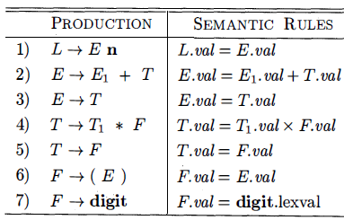
Inherited and Synthesized Attributes..
This SDD is based on grammar for arithmetic expressions with operators + and *.
It evaluates expressions terminated by an endmarker n.
Each of the non-terminals has a single synthesized attribute, called val
We also suppose that the terminal digit has a synthesized attribute lexval which is an integer value returned by the lexical analyzer.

Slide 34

Evaluating an SDD at the Nodes of a Parse Tree
A parse tree, showing the value(s) of its attribute(s) is called an annotated parse tree.
For SDD's with both inherited and synthesized attributes, there is no guarantee that there is even one order in which to evaluate attributes at nodes.
For instance, consider non-terminals A and B, with synthesized and inherited attributes A.s and B .i, respectively, along with the production and rules

Slide 35
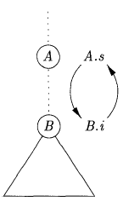
Evaluating an SDD at the Nodes of a Parse Tree..
Circular Rules
It is impossible to evaluate either A.s at a node N or B.i at the child of N without first evaluating the other.
It is computationally difficult to determine whether or not there exist any circularities in any of the parse trees that a given SDD could have to translate.
There are some useful subclasses of SDD 's that are sufficient to guarantee that an order of evaluation exists.

Slide 36
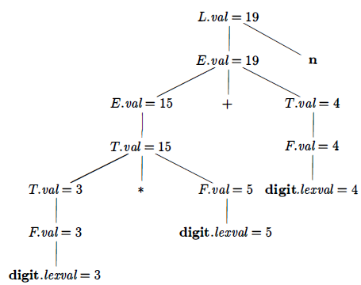
Evaluating an SDD at the Nodes of a Parse Tree...
Annotated parse tree for the input string 3 * 5 + 4 n
The values of lexval are presumed supplied by the lexical analyzer
Each of the nodes for the non-terminals has attribute val computed in a bottom-up order

Slide 37
Thank You

